Slide 1
Organic Food World
A website about organic food
Information about your nearest farmer or supermarket, where you can get it and a delivery service

Slide 2
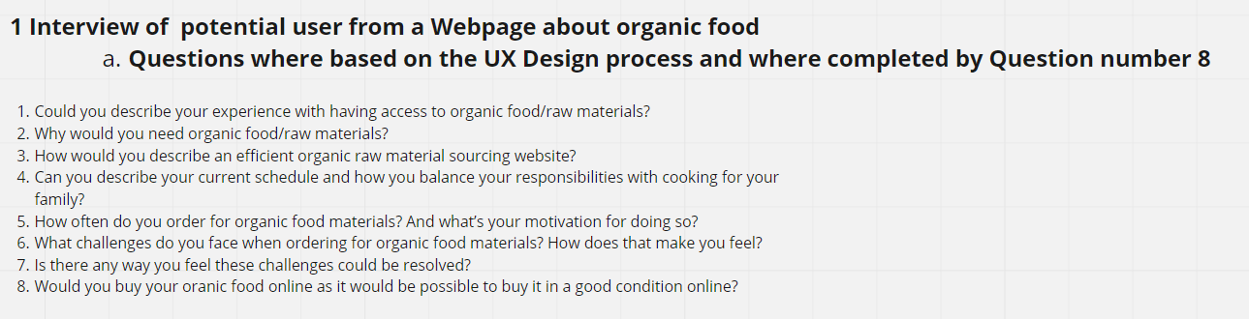
Protoypprocess (original created with miro)

Slide 3
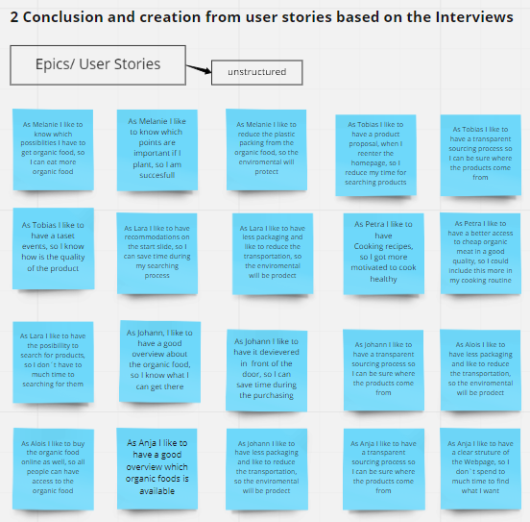
Protoypprocess (original created with miro)

Slide 4
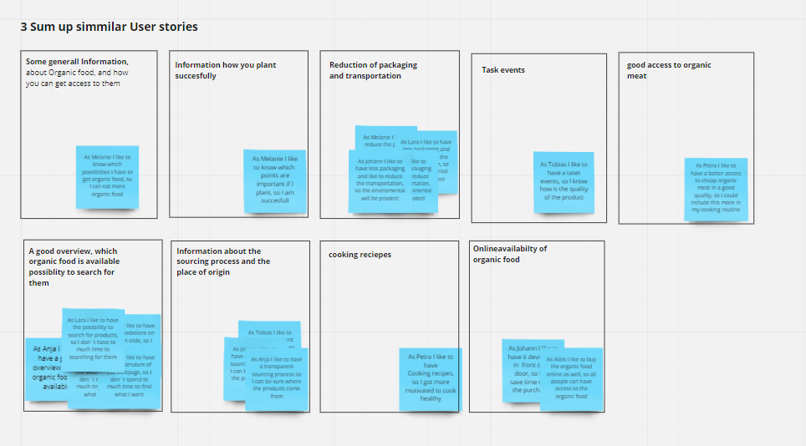
Protoypprocess (original created with miro)

Slide 5
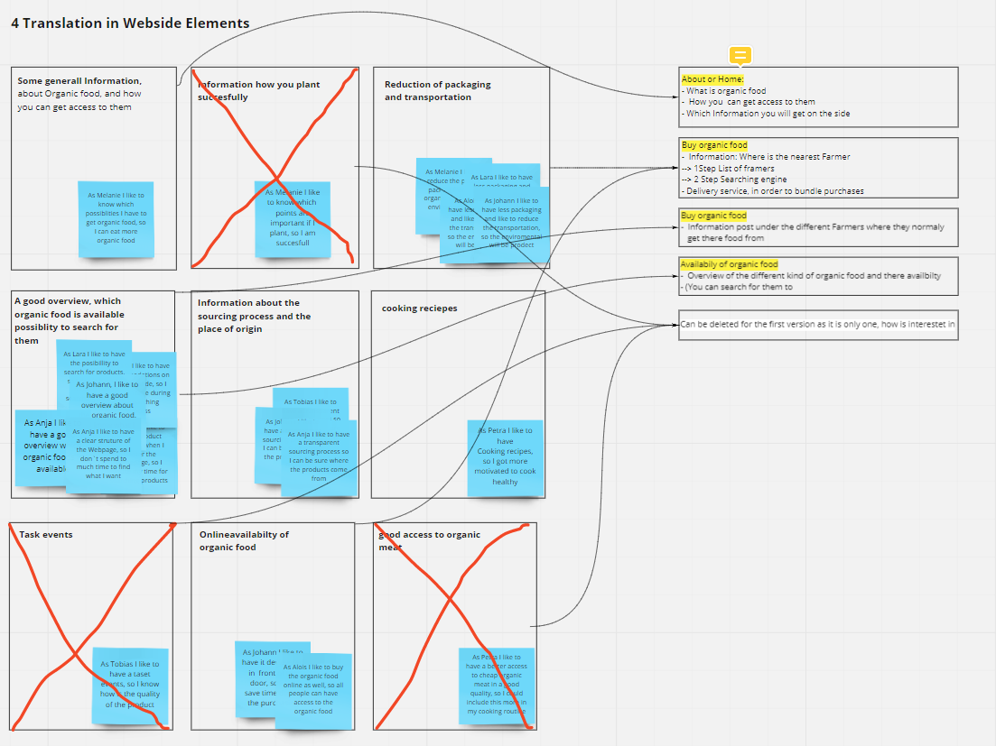
Protoypprocess (original created with miro)

Slide 6
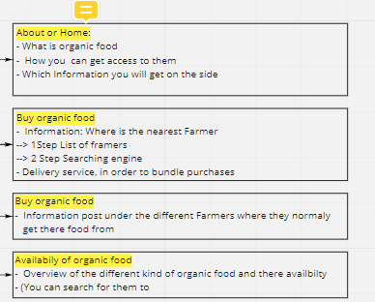
Website Elements (original created with miro)
Yellow marked text stand for a Topic, which can be used in a tab

